Slide 1
PROJECT TITLE SECURE DATA HIDING IN IMAGES USING STEGANOGRAPHY
SECURE THE DATA TO PREVENT HACKERS
Presented By: GNANARATHINAM C
Student Name : GNANARATHINAM C
College Name & Department : RMD ENGINEERING COLLGEG (ECE)

Slide 2
OUTLINE
Problem Statement
Technology used
Wow factor
End users
Result
Conclusion
Git-hub Link
Future scope

Slide 3
Problem Statement: Image-Based Text Encryption and Decryption System
Secure Data Hiding:
Developing a method to embed text messages into an image at the pixel level without significantly altering the visual appearance.
Confidentiality and Access Control:
Implementing a passcode-based security mechanism to restrict unauthorized decryption of the hidden message
Efficient Message Retrieval:
Ensuring that the hidden message can be accurately retrieved from the image without data loss or corruption.
Image Processing Constraints:
Handling image pixel limitations and ensuring proper mapping of text data into RGB values while maintaining image integrity.
Cross-Platform Usability:
Making the system compatible across different operating systems without dependency issues in reading, writing, and displaying images.

Slide 4
Technology used
Programming Language:
Python is used as the core programming language for implementing image-based encryption and decryption.
Libraries Used:
OpenCV (cv2): For reading, modifying, and saving image files during the encryption and decryption process.
OS Module: For handling file operations such as opening the encrypted image automatically after processing.
Concepts Applied:
Image processing techniques for pixel manipulation.
Dictionary-based character encoding and decoding to store and retrieve secret messages.
Development Environment:
The project is implemented and executed in VS Code (Visual Studio Code) as the Integrated Development Environment (IDE).

Slide 5
Wow factors
Image-Based Encryption:
Unlike traditional text-based encryption, this project embeds a secret message directly into image pixels.
Passcode Protection:
Ensures that only authorized users can decrypt the hidden message, enhancing security
Lightweight and Fast:
Uses minimal resources while maintaining high efficiency in encoding and decoding messages.

Slide 6
End users
Cybersecurity Enthusiasts:
Individuals interested in learning and implementing encryption techniques for secure communication.
Forensic Experts & Investigators:
Can use this technique for confidential data storage and retrieval in digital forensics.
Journalists & Whistleblowers:
Useful for securely hiding sensitive information in images to avoid detection.
Software Developers & Researchers:
Beneficial for those exploring steganography and image-based encryption for secure applications.

Slide 7


Results
Image Before Encryption
Image After encryption

Slide 8
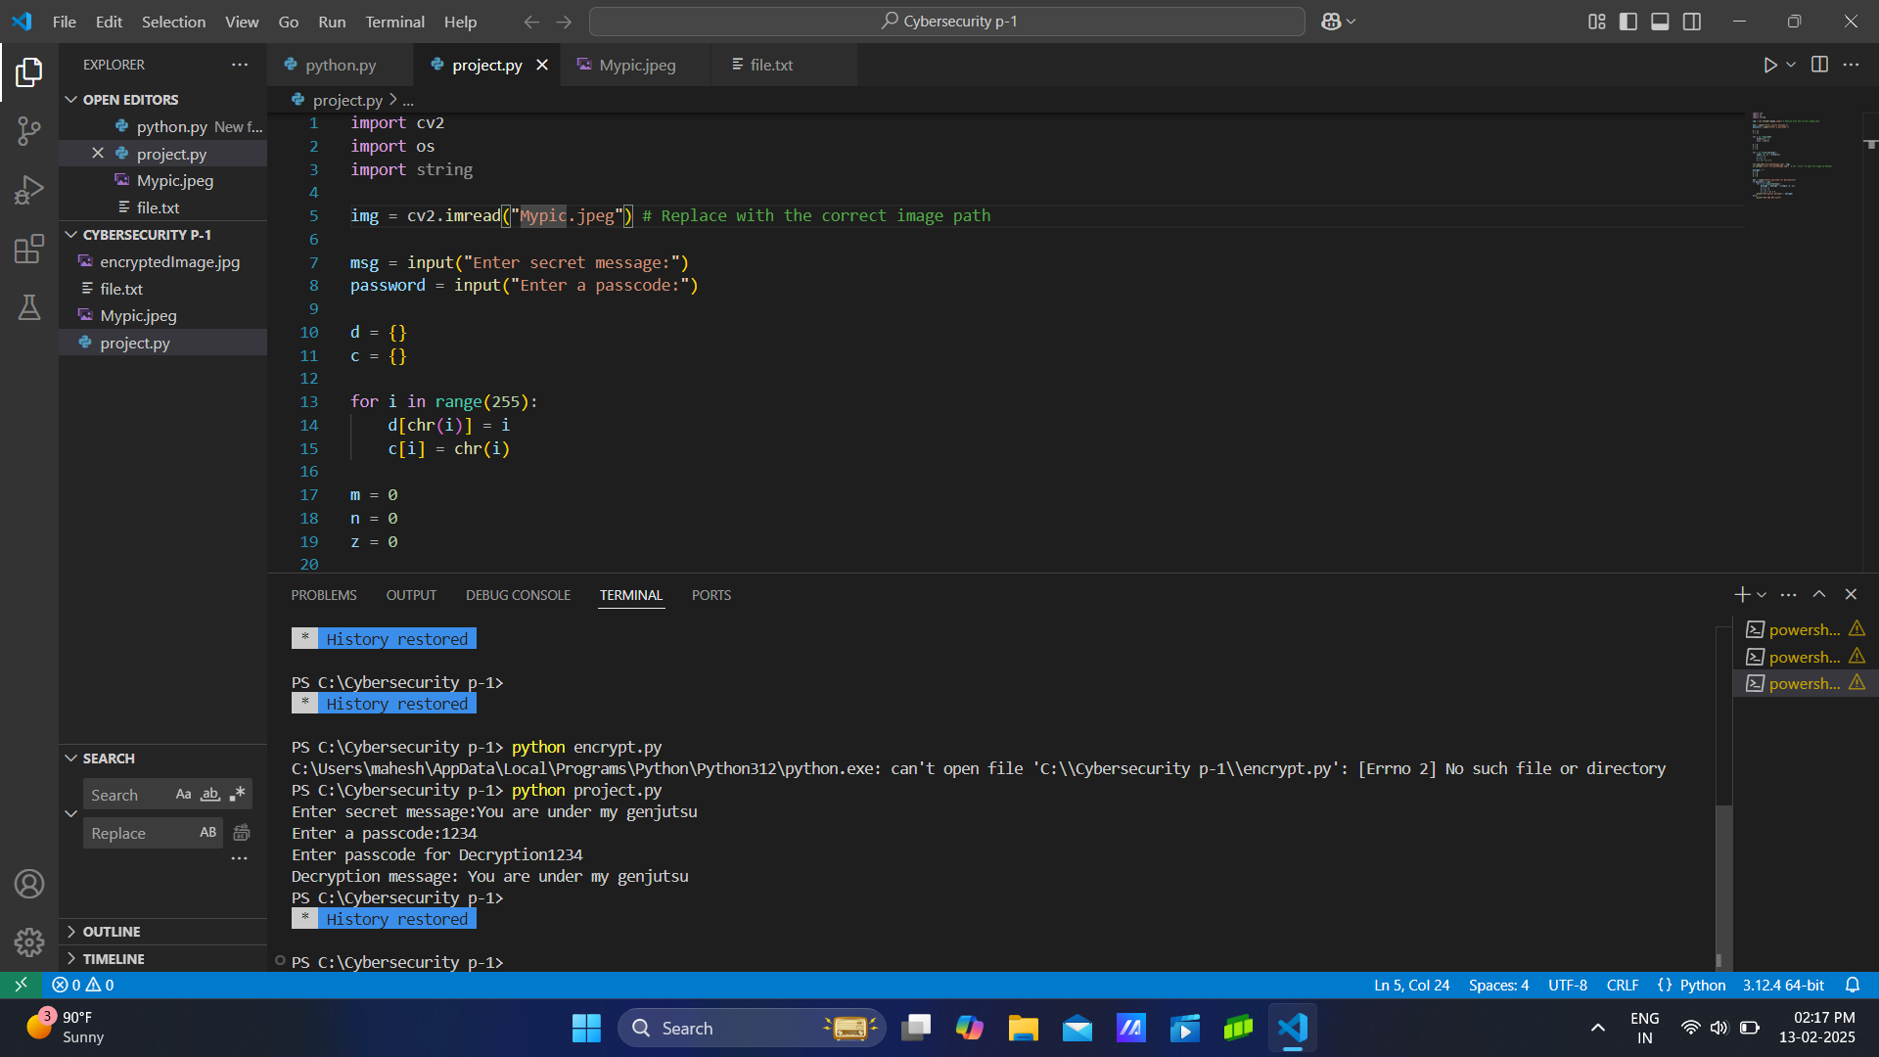
Encryption and decryption screenshot

Slide 9
Conclusion
Secure Data Hiding:
The project successfully embeds secret messages within an image using pixel manipulation, ensuring discreet communication
Passcode Protection:
A passcode-based authentication system enhances security, preventing unauthorized access to the hidden message.
Efficient and Lightweight:
The approach is simple yet effective, utilizing Python and OpenCV while maintaining the image's visual integrity.
Real-World Applications:
This technique can be applied in cybersecurity, forensic investigations, and secure communication systems.

Slide 10
GitHub Link
Code Transparency & Collaboration:
Hosting the project on GitHub enables version control, issue tracking, and collaboration with developers worldwide.
Code Transparency & Collaboration:
Hosting the project on GitHub enables version control, issue tracking, and collaboration with developers worldwide.
GITHUB FILE LINK: Rathinam288/Cybersecurity

Slide 11
Future scope(optional)
Advanced Encryption Techniques: Implement
stronger encryption algorithms like AES or RSA to enhance security and prevent unauthorized decryption.
Multi-Format Support:
Extend support to hide messages in various file formats, including PNG, BMP, and even video
files for broader applications.
Automated & Cloud-Based System:
Develop a web or mobile application that allows users to encrypt and decrypt messages
online with cloud storage integration.

Slide 12
THANK YOU

